Slide 1


Finance and Banking
GROUP 3

Slide 2

CONTENTS
Purpose
User Management
Account Management
Transaction and Payment Services
Investment Services
Loan and Credit Services
Insurance Services
Financial Planning and Advisory
Customer Support
Services Section
About Section

Slide 3
Purpose
Our bank financing website aims to offer a comprehensive and easy-to-use platform that meets our clients' various financial demands. Several components make up the system, which guarantees a safe and easy banking experience. The "Sign Up" and "Log In" modules facilitate the process of account creation and provide individualized financial services to users. The sections labeled "Account Overview" and "Account Management" enable clients to effectively oversee and manage their personal information. Our dedication to supporting financial growth is obvious in the presence of "Investment Services," "Loan and Credit Services," and "Insurance Services."

Slide 4
Purpose
The system includes comprehensive "Transaction and Payment Services" for smooth transactions. To help consumers make wise decisions, the website also provides helpful "Financial Planning and Advisory" services. We have included a specialized "Customer Support and Help Center" to promptly resolve inquiries in order to improve the overall customer experience. The "About" part gives accessibility and insight into our institution's principles and goals, while the "Services" section serves as a one-stop shop for all the services that our system is offering. Our bank finance website hopes to be a reliable companion in our clients' financial endeavors by offering these modules.

Slide 5

1. User Management
- Sign Up Module: enables platform account creation for users.
- Log In Module: Offers safe entry to user profiles.
2. Account Management
- Account Overview Module: Shows the user's information.
- Account Management Tools: Gives users the ability to edit account information.

Slide 6


3. Transaction and Payment Services
- Transfer Funds Module: Enables quick and safe money transfers.
- Bill Payment Services: Facilitates bill payment.
- Transaction History: Records all transaction in the account.

Slide 7

4. Investment Services
- Investment Tools: Offers investment advising services, portfolio tracking, and real-time market data.
5. Loan and Credit Services
- Personal Loan Application Module: Facilitates personal loan applications.
- Auto and Recreational Loan Application Module: Facilitates Auto and Recreational loan applications.

Slide 8


6. Insurance Services
- Insurance Product Information: Offers specifics on the range of available insurance packages.
7. Financial Planning and Advisory
- Financial Advisory Tools: Provides professional guidance and educational videos for financial planning

Slide 9

8. Customer Support
- Customer Support Module: Provides avenues for resolving user questions and concerns, including live chat, email, and FAQs.
9. Services Section
- Information Hub: A centralized component with information on all of the financial services the organization offers.

Slide 10

10. About Section
- Institutional Information: Provides openness and understanding of the goals, principles, and purpose of the organization to financial services. It also introduces the team members involved in the making of the system.

Slide 11

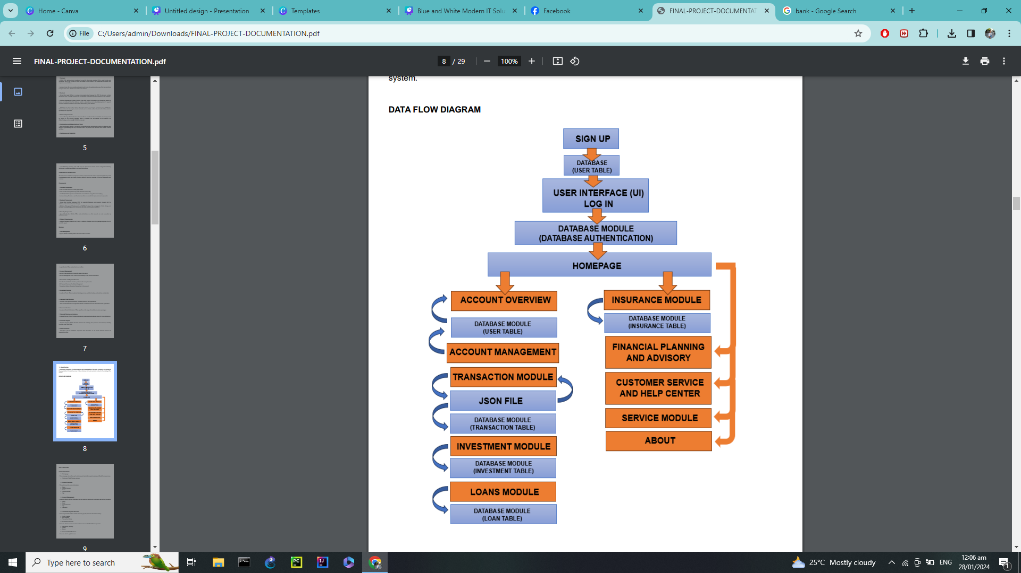

Data Flow Diagram

Slide 12

Thank You!

